Slide 1





Stock Price Prediction by Algorithms Trading

Slide 2


Project Objective:
Stock price prediction by trading algo. is the act of trying to determine the future value of a company stock or other instrument traded on an exchange. The successful prediction of a stock's future price could yield a significant profit( ). we need to forecast the stock price for days that we determined so, we used time series analysis and forecasting to predict the returns on a stock for that days (i.e., predict future data points (returns) in a time of days).
- Fundamental analysis (Accounting)
- Technical analysis (Charting)
- Algorithmic Trading (ML Quant Developer ) …

Slide 3


Problems
Markets are complex systems and chaotic systems with complex dynamics, yet to a certain extent we can make valid stock market forecasts. Using these forecasts generated by cutting-edge predictive algorithms together with a careful risk management strategy may give a trader a significant competitive advantage.

Slide 4

Solution
Auto-regression:
ARIMA Model
SARIMA Model
Linear Machine Learning:
Linear Regression
Losso Regression
Elastic Net Regression
Deep Learning:
LSTM
Additive Model

Slide 5



Technical Tools
Numpy
Pandas
Matplotlib
Datetime
Pandas_datareader
Quandl
Candlestick
Fbprophet
Pytrends
Pystan
Py Library
PyAlgoTrade

Slide 6




Steps:
1- Load Dataset
2- Analysis of stock price data by Python
3- Predict of stock price data by R
4- Stock price by Shiny API
5- Big Data by PySpark:
6- Facebook Tools

Slide 7
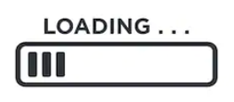




Load Data

Slide 8
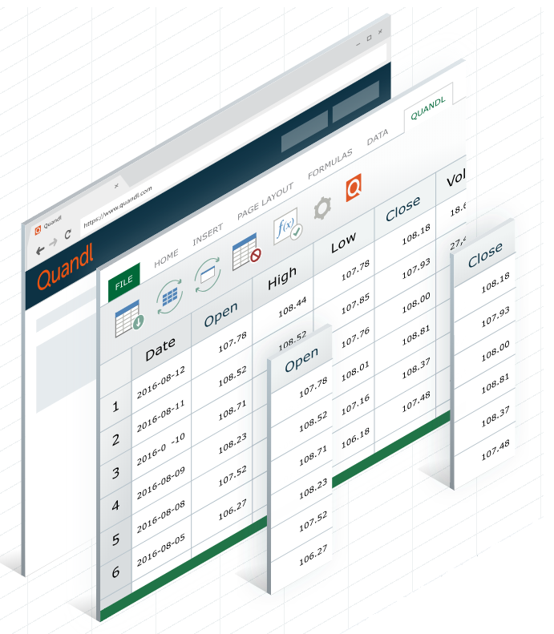
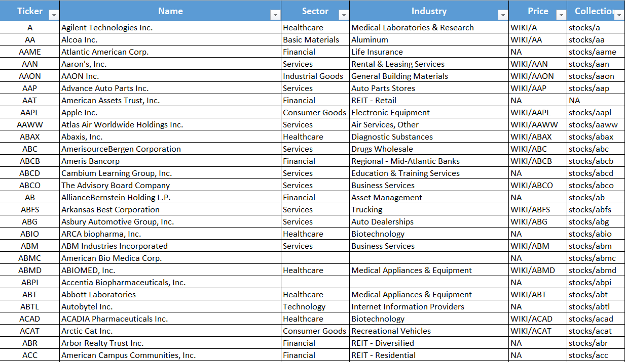

Symbol Dataset

Slide 9
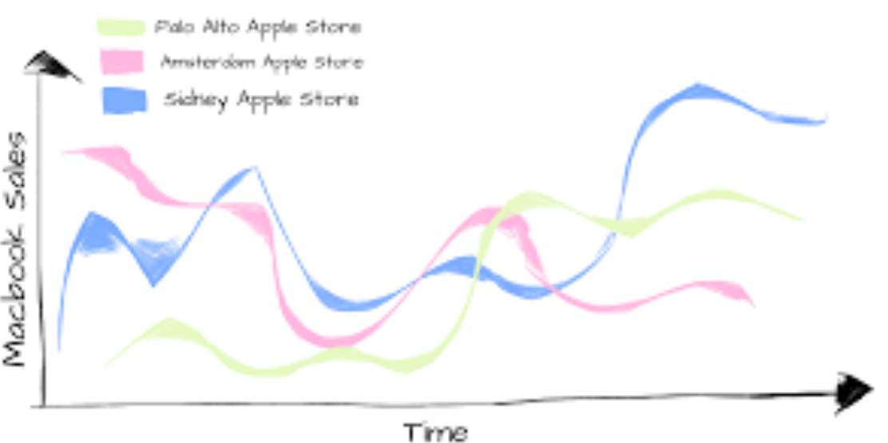

Main Concepts:
1- Weekend and Holiday (252) -> Adj. Close
2- More Features -> Candlestick
3- Trend - Non-Stationary
Differencing (I) -> adf.
Auto-Regression (AR) -> ACF
Moving Average (MA) -> PACF
4- Noise (random) -> Ignore Outlier
5- 3+ Change point -> Additive Model
-> Constant mean, Variance

Slide 10
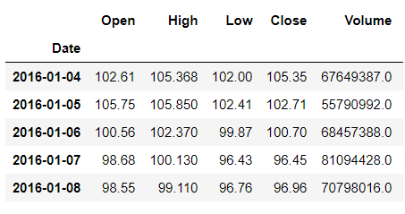
1- Weekend and Holiday → Adj. Close
K = Close / Adj. Close
Adj. Open = Open * K
Adj. High = High * K
Adj. Low = Low * K
Adj. Close = Close * K

Slide 11
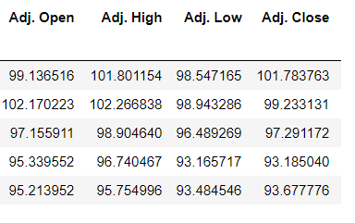
1- Weekend and Holiday → Adj. Close

Slide 12
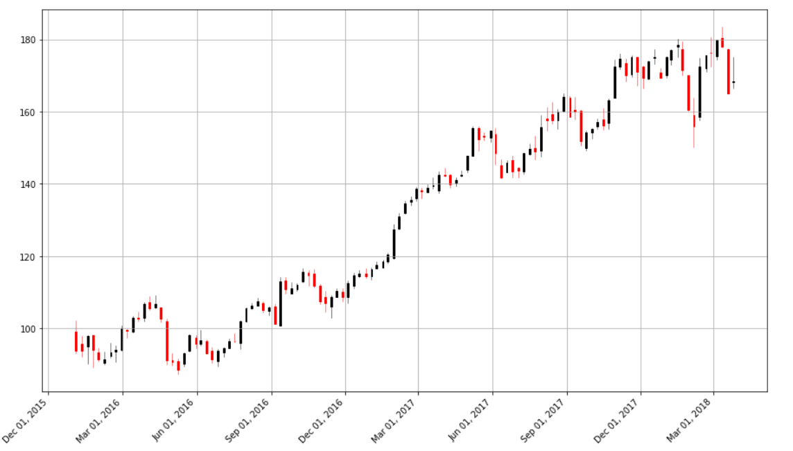
2- More Features → Candlestick OHLC

Slide 13
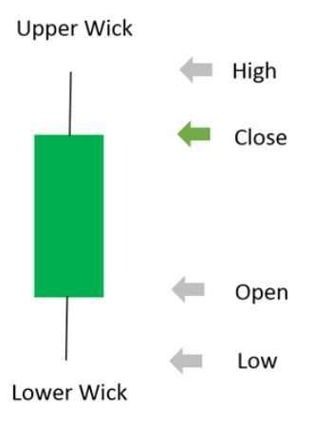
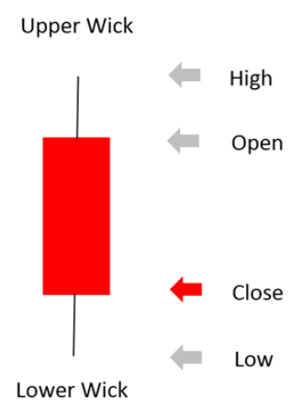
2- More Features → Candlestick OHLC

Slide 14
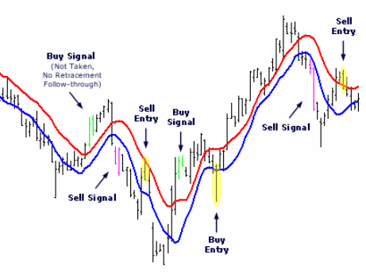
2- More Features → Candlestick OHLC → Moving Average

Slide 15
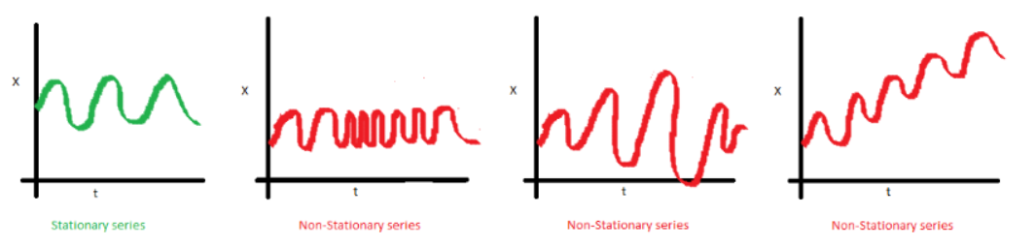
3- Stationary vs Non-Stationary

Slide 16
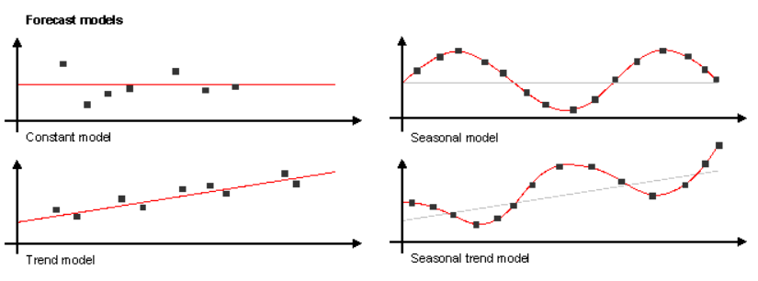
4- Trend vs Non-Stationary

Slide 17
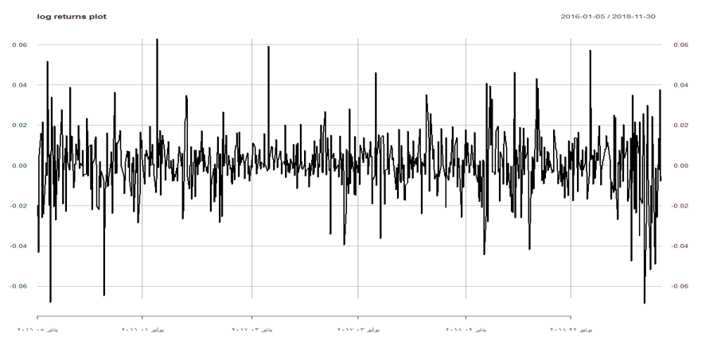
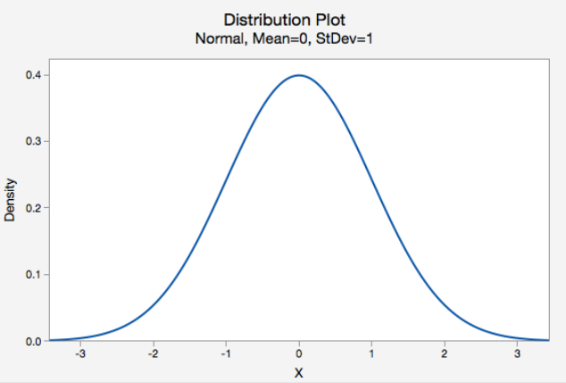
3- Trend + Non-Stationary + Seasonal → ARIMA → Additive Model
AR I MA
Additive Model
ARIMA stands for Autoregressive Integrated Moving Average. ARIMA is also known as Box-Jenkins approach. Box-Jenkins claimed that non-stationary data can be made stationary by differencing the series. The ARIMA(P,d,q) model combines three basic methods
Forecasting non-linear
Trend + Random + Seasonal
ACF: Auto-correlation Function
PACF: Partial Auto-Correlation Function
I: Differencing
ACF (P)
I (D)
PACF (Q)
Constant mean, variance

Slide 18

Stock Price Analysis - Python

Slide 19
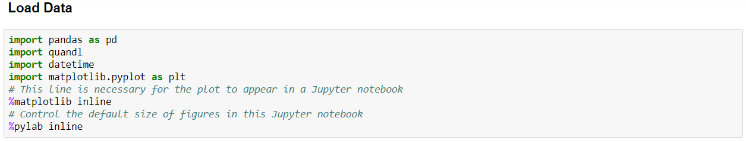
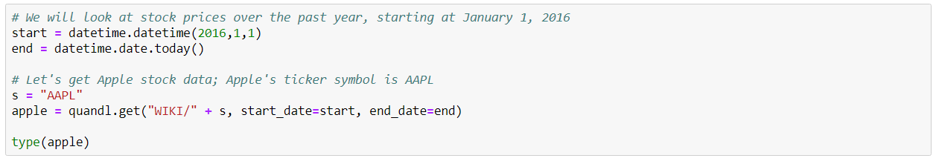

Slide 20
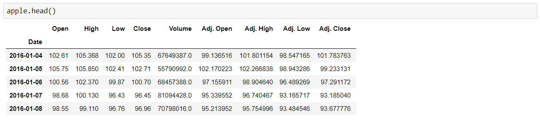

Slide 21
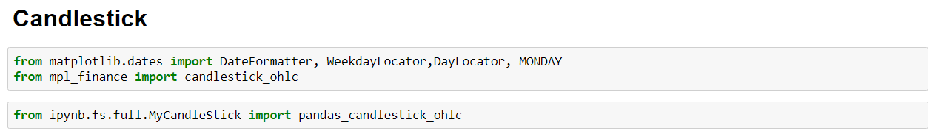

Slide 22
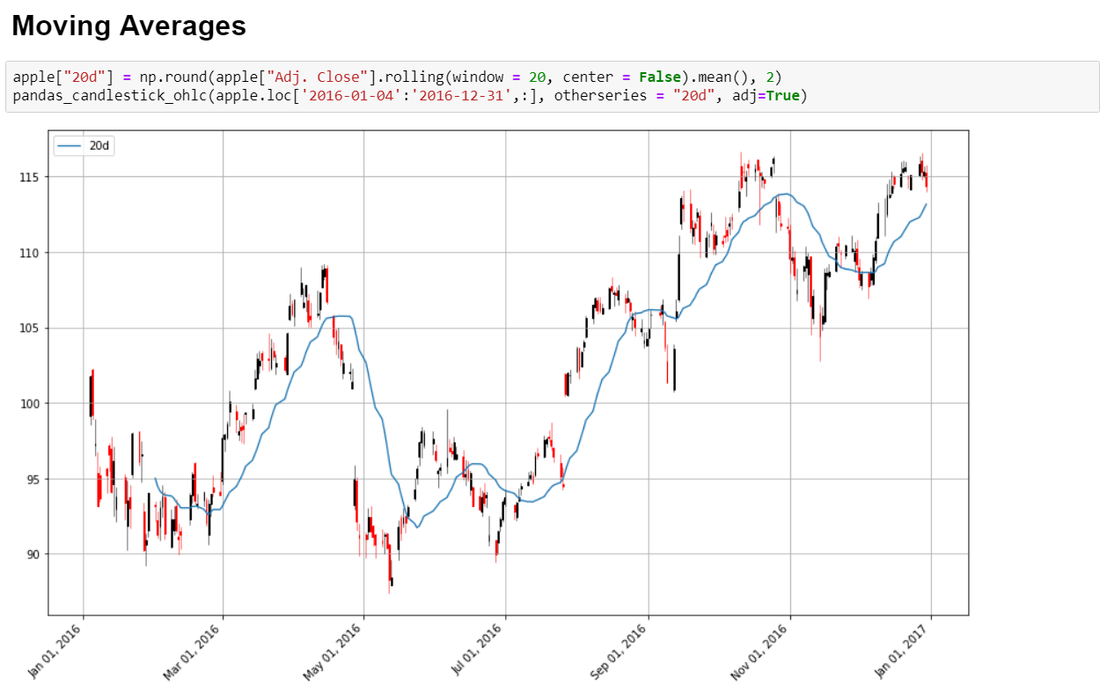

Slide 23
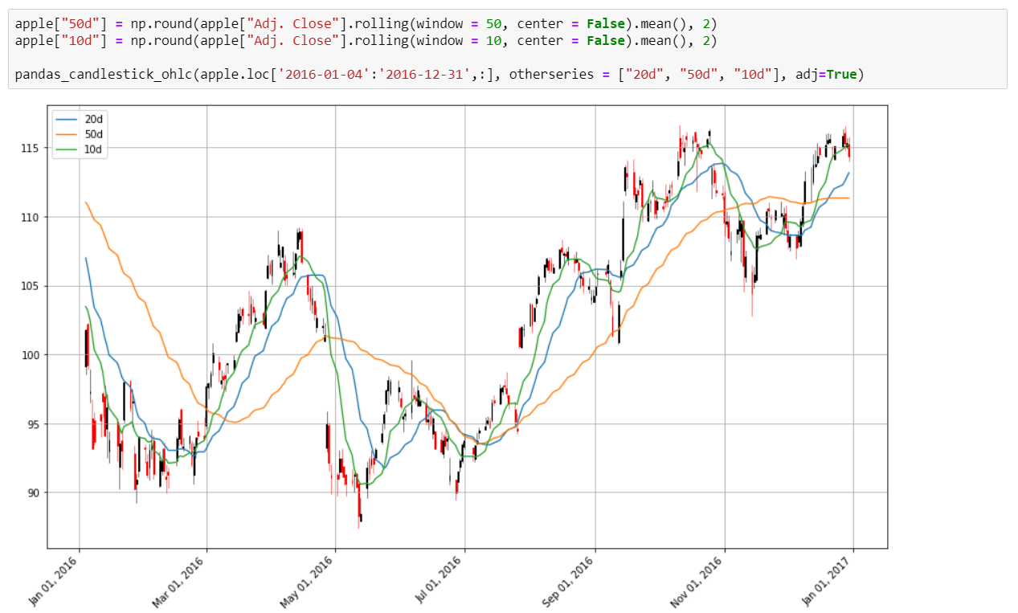

Slide 24
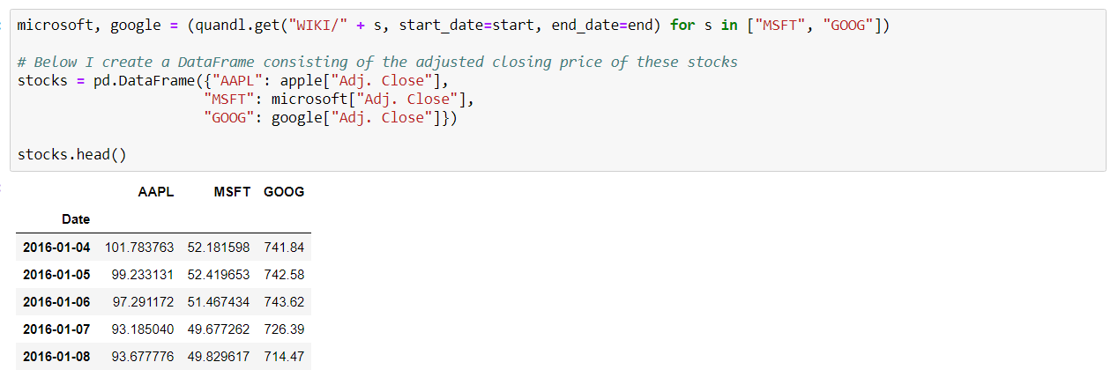

Slide 25
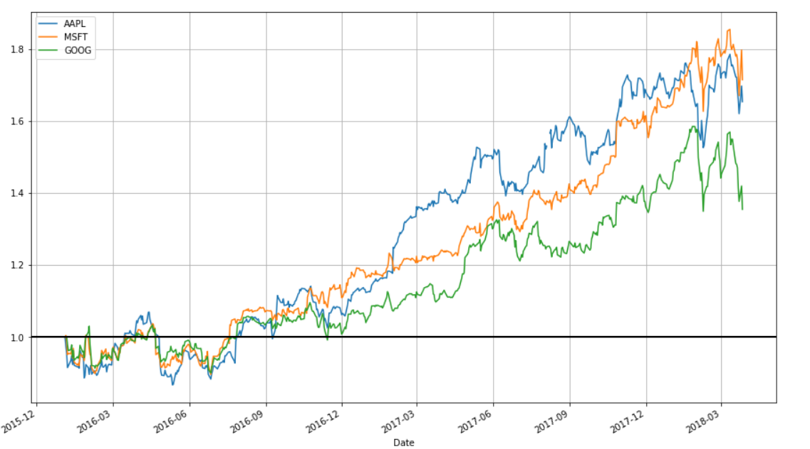

Slide 26
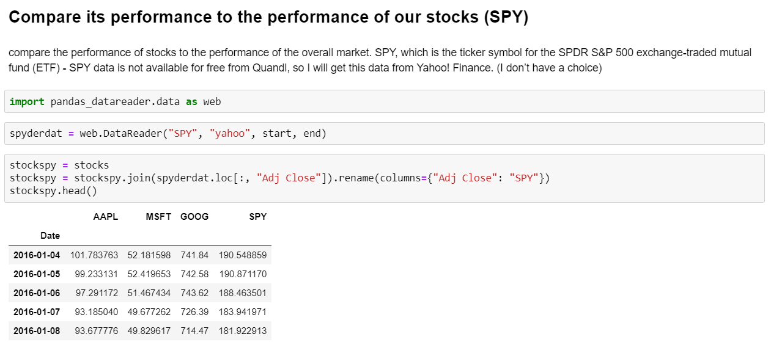

Slide 27
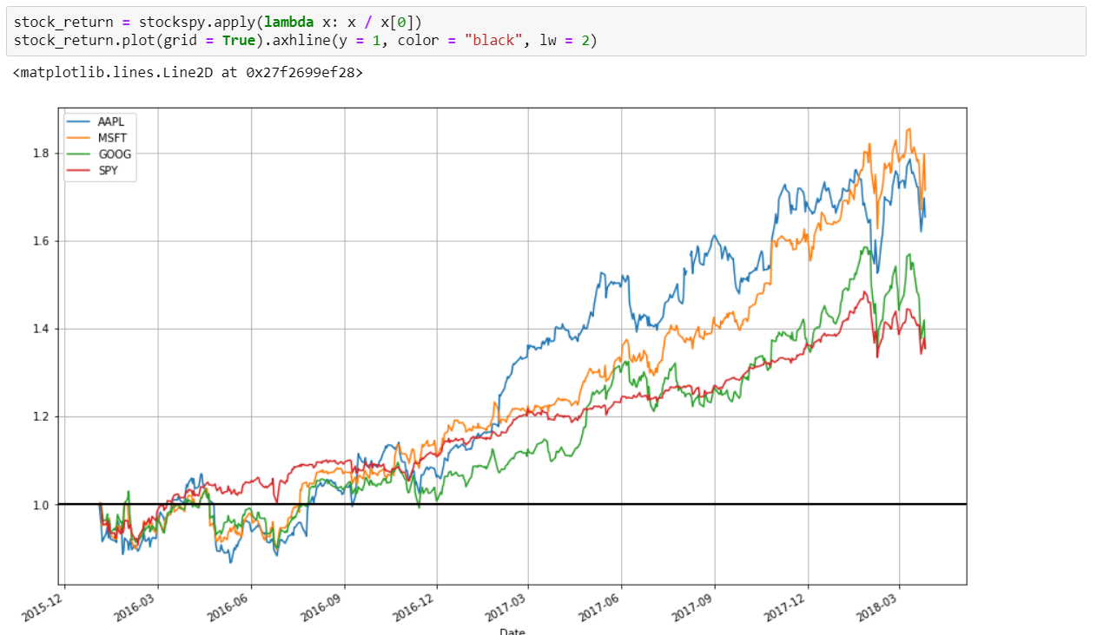

Slide 28
ARIMA Prediction - Stock Price

Slide 29
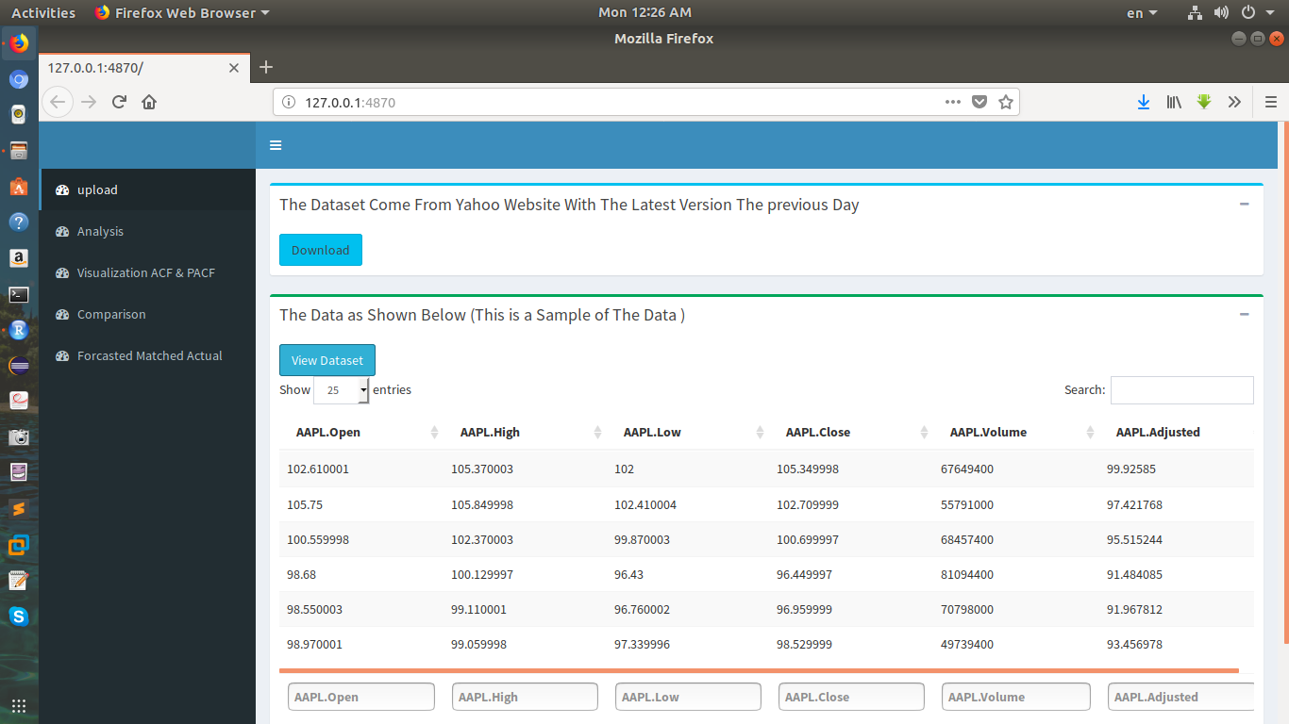

Slide 30
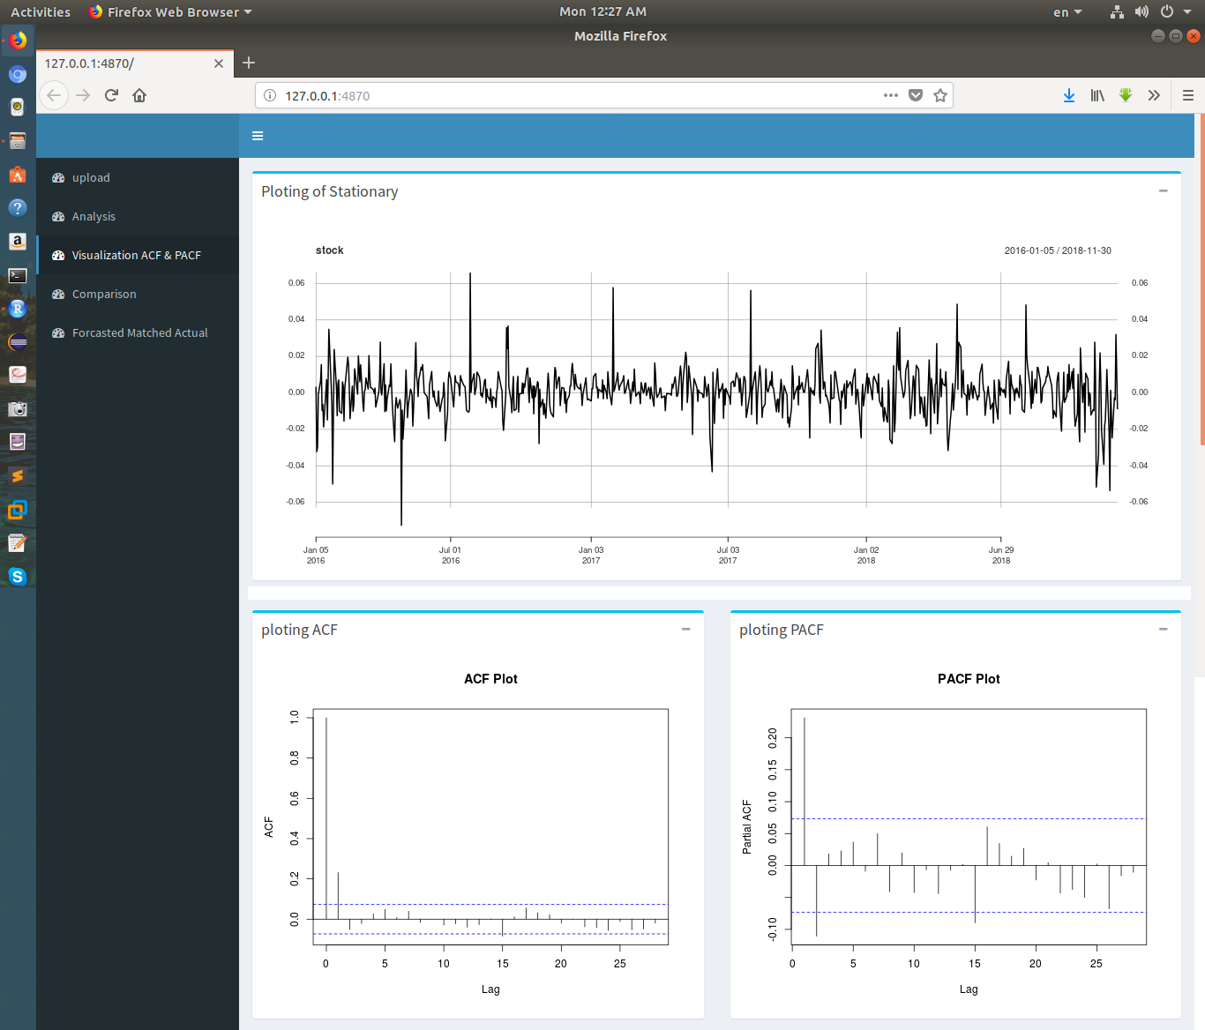

Slide 31
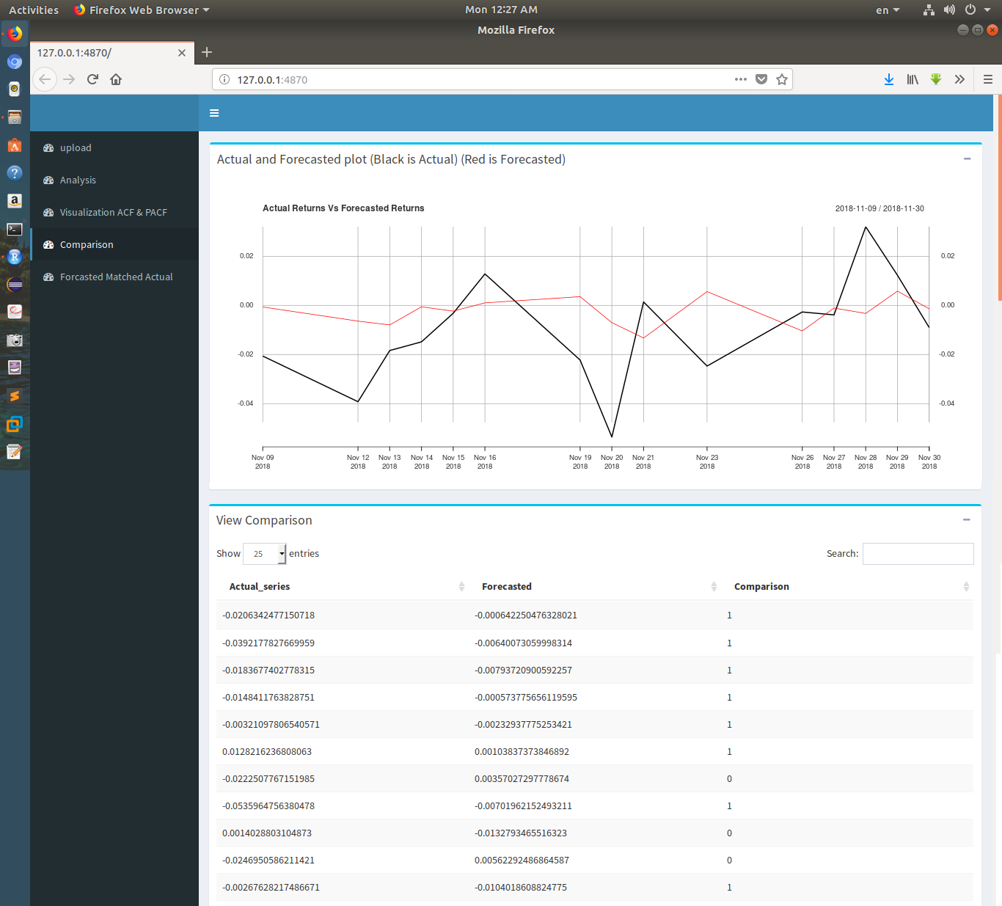

Slide 32
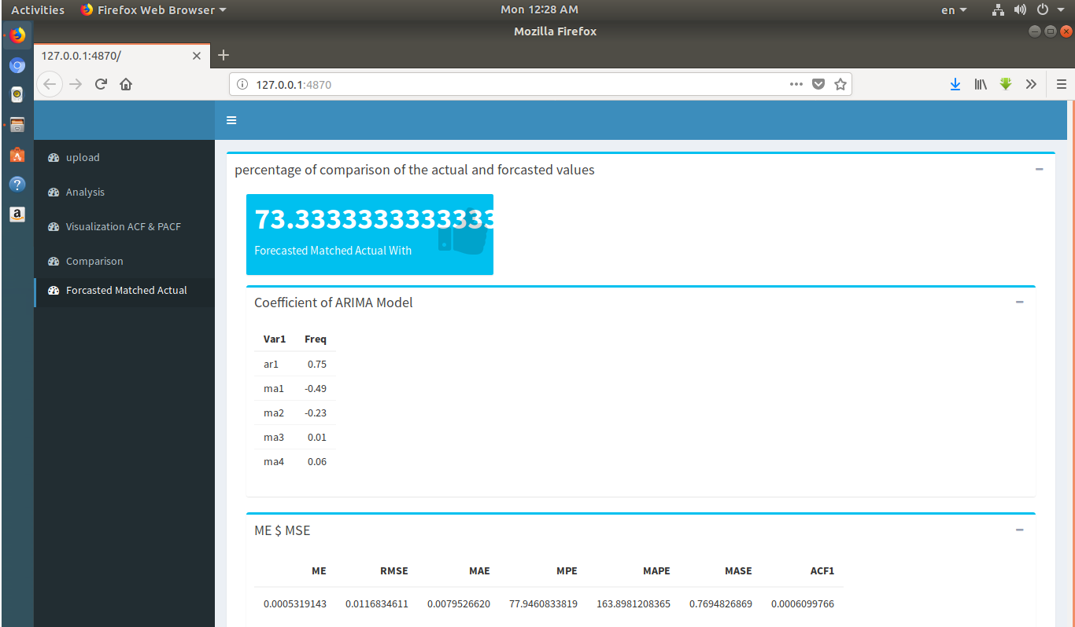

Slide 33


Slide 34
Stock Price Using PySpark
Apache Spark has become one of the most powerful framework for big data processing because of its in-memory computing capabilities.
The ability to run these computations in memory. It's ability to cache and process data in memory, makes it significantly faster for iterative applications.
This is proven to provide a factor of ten or even 100 speed-up in the performance of some algorithms, especially using large data sets.
Additionally, Spark provides support for batch and streaming workloads at once.

Slide 35
Resilient Distributed Datasets
The Dataset can be partitioned and distributed across multiple nodes
An RDD is Spark's representation of a dataset that is distributed across the RAM, or memory, of lots of machines.
An RDD object is essentially a collection of elements that you can use to hold lists of tuples, dictionaries, lists, etc.
Lazy Evaluation : the ability to lazily evaluate code, postponing running a calculation until absolutely necessary.
This brings the concept of actions and transformations.

Slide 36
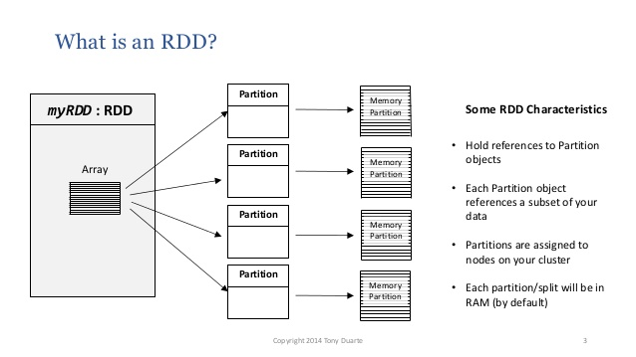
Resilient Distributed Datasets Cont.

Slide 37
The Spark Stack
SparkSQL
Spark
Streaming
MLlib
GraphX
Spark Core

Slide 38
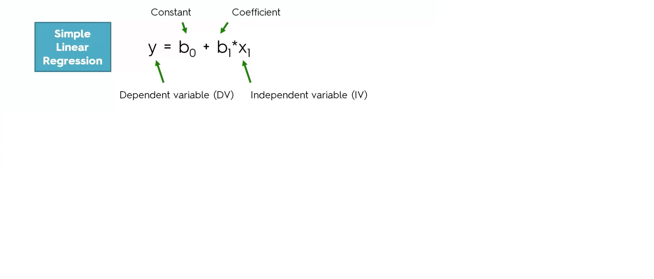
Linear Regression Using PySpark

Slide 39
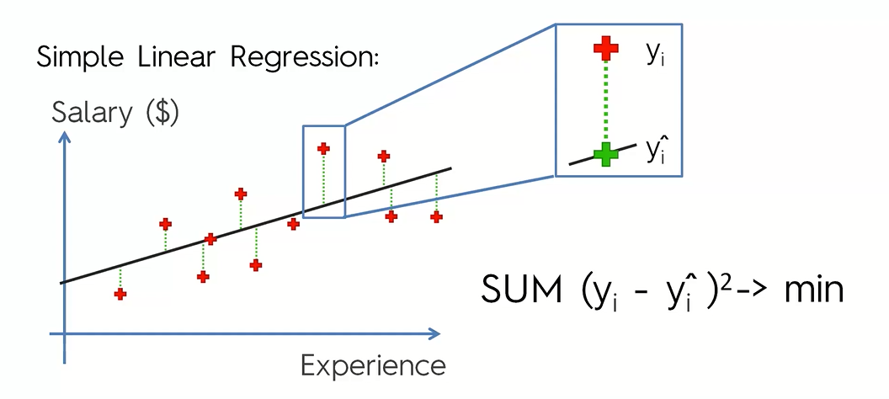
Linear Regression Goodness of Fit

Slide 40
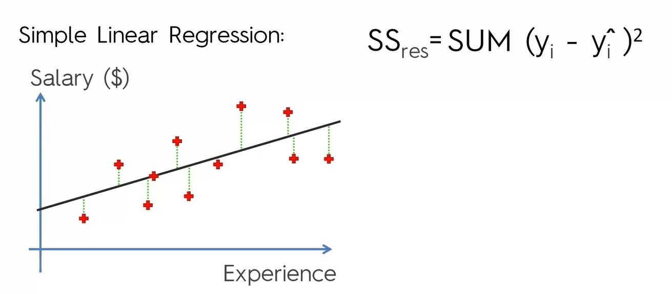
Sum Square Residuals

Slide 41
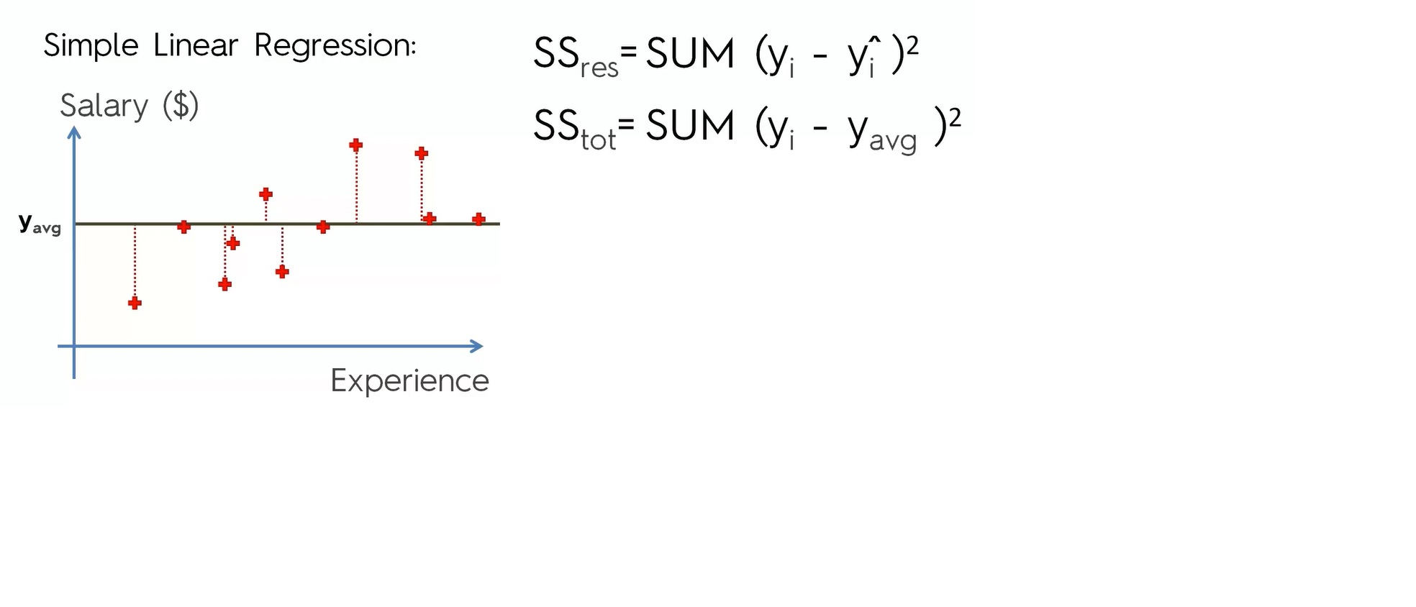
Sum Square Total

Slide 42
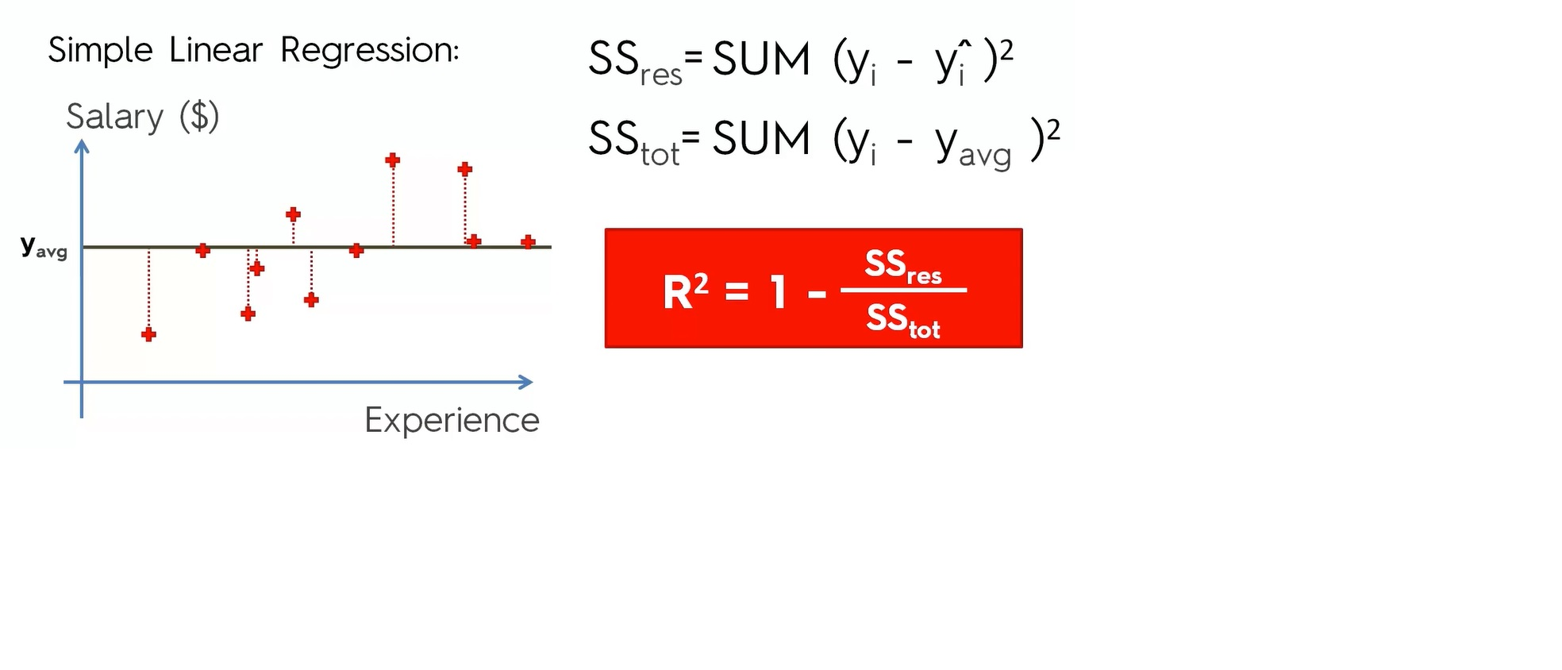
R Squared

Slide 43
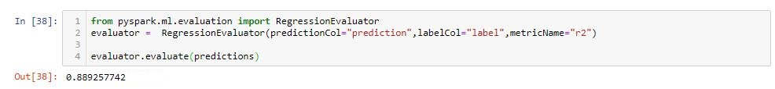
Evaluation

Slide 44
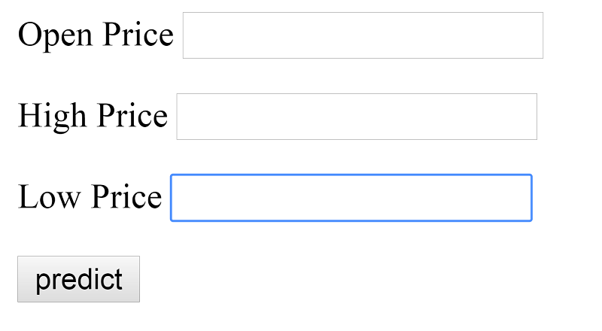
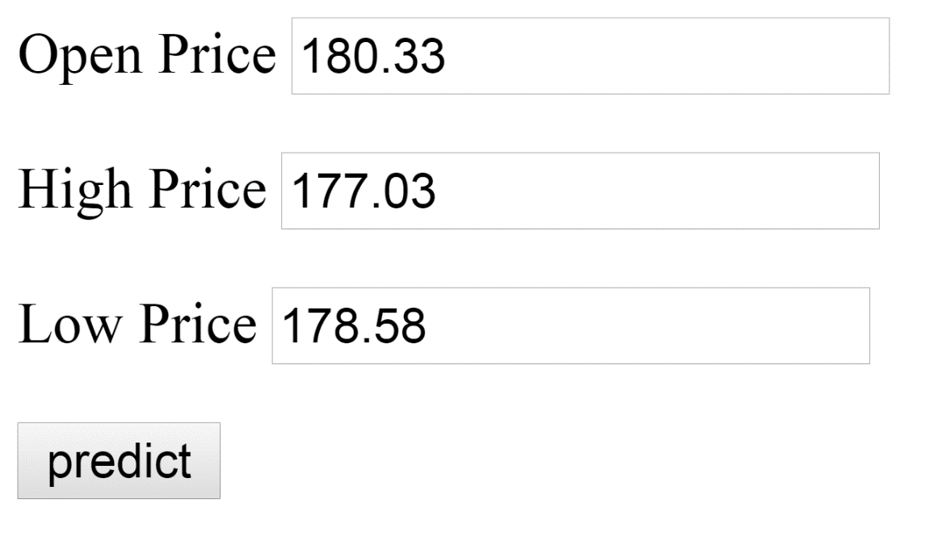
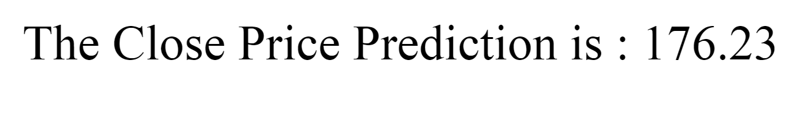
Creating API to Predict Close Price

Slide 45



Slide 46
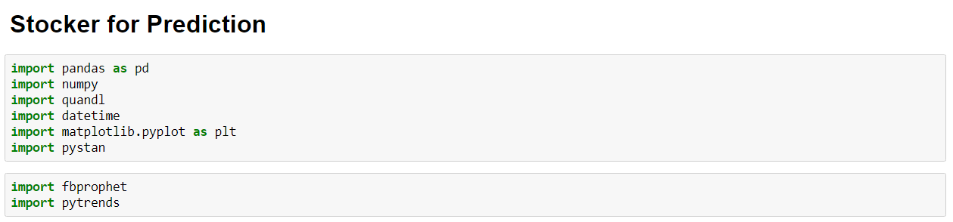




Slide 47
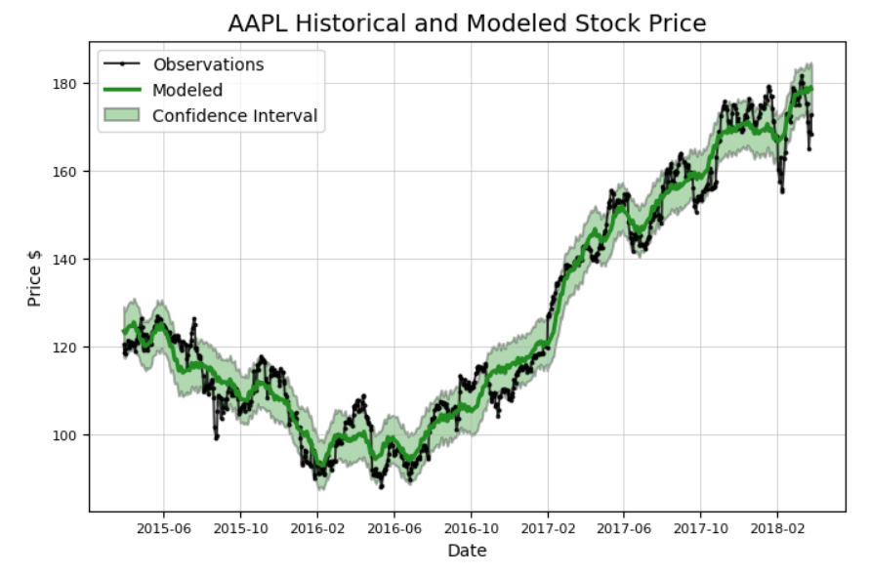
Adj. Close
Additive Model - predict
Max-Min Range

Slide 48
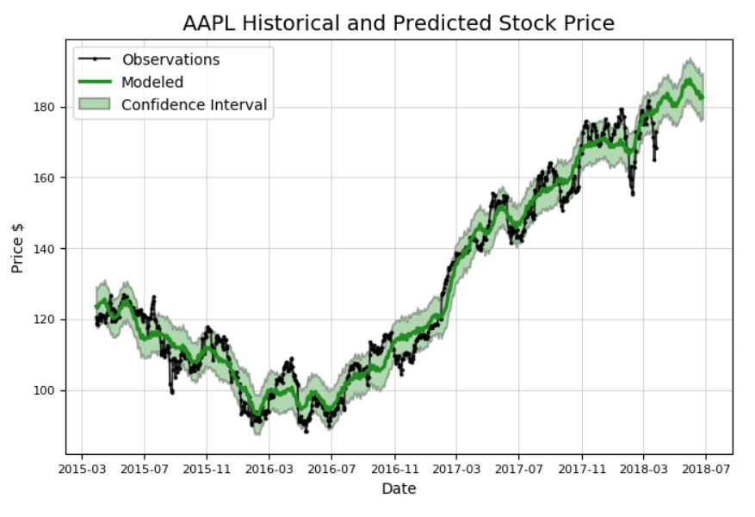
Adj. Close
Additive Model -> predict
Max-Min Range
Accuracy: Predict 90 days = 97.19 %

Slide 49
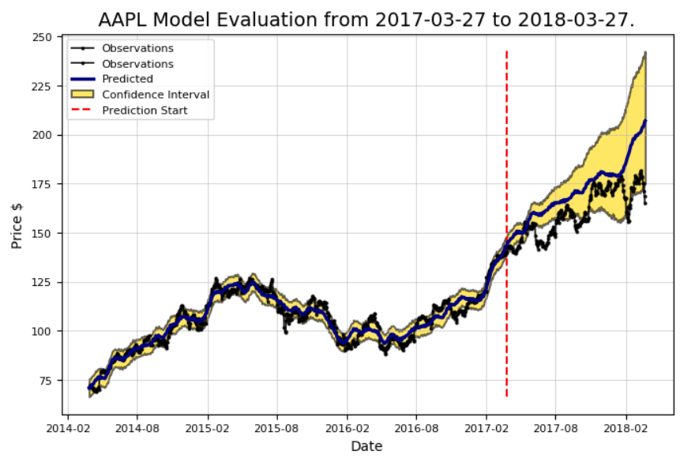
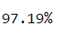
Adj. Close (HL)
Additive Model -> predict
Max-Min Range

Slide 50
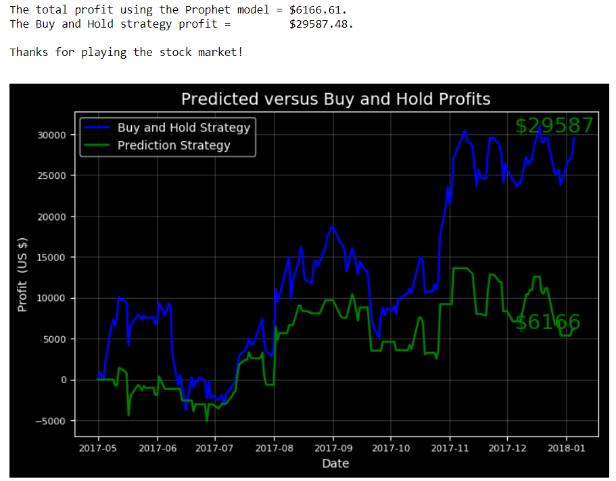

Slide 51


